Slide 1


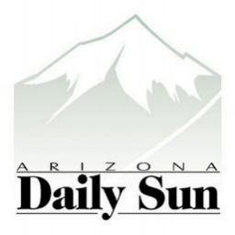

An Interdisciplinary approach to Scientific Translation and Communication or Why we need Popular Science Journalism
Taylor Hartman
Mentor: Randy Wilson
Notes:
How exciting, and what a wonderful opportunity, as a popular science journalist, it is to be here in ahotel full of budding research, with bright students willing to talk to you

Slide 2
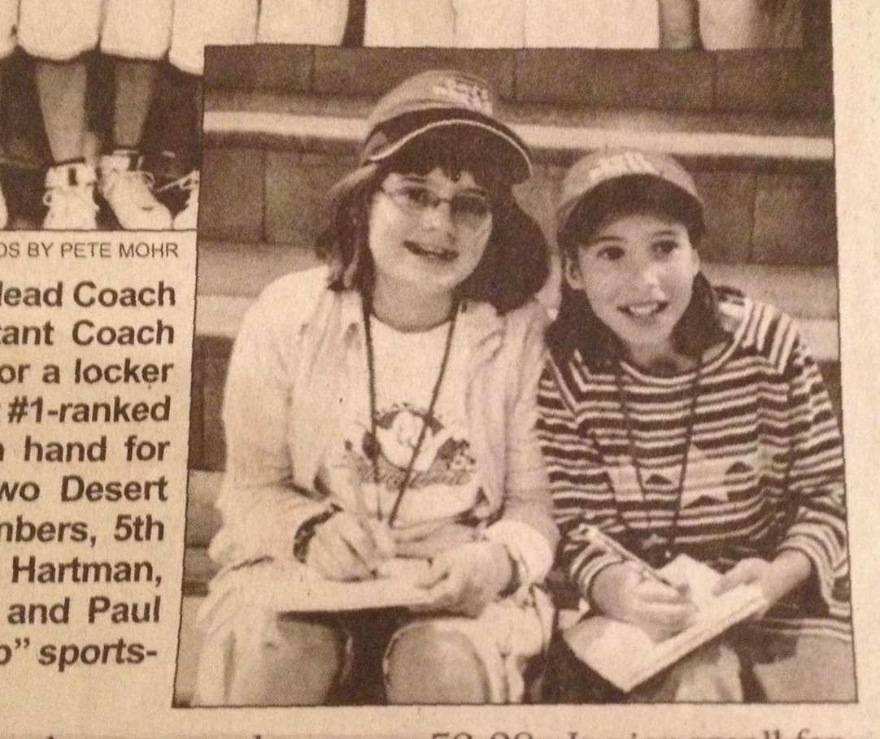
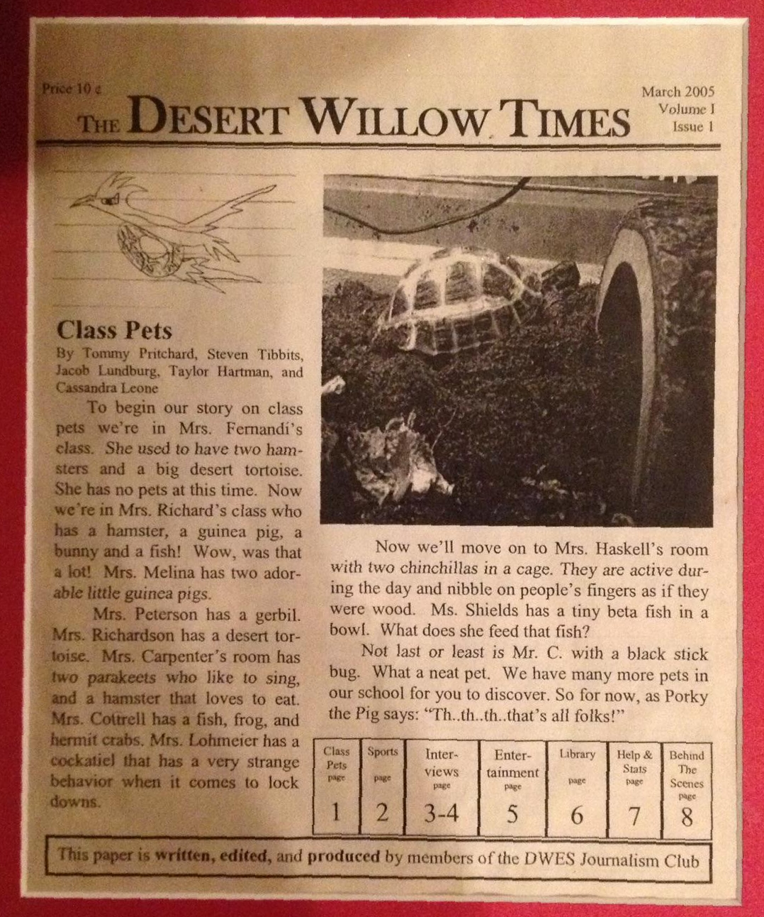
Purpose
Internship experience at The Arizona Daily Sun
Learn techniques for successful popular science writing
Communicate science news in exciting, accessible way
On assignment, 2005
First headline, 2005

Slide 3
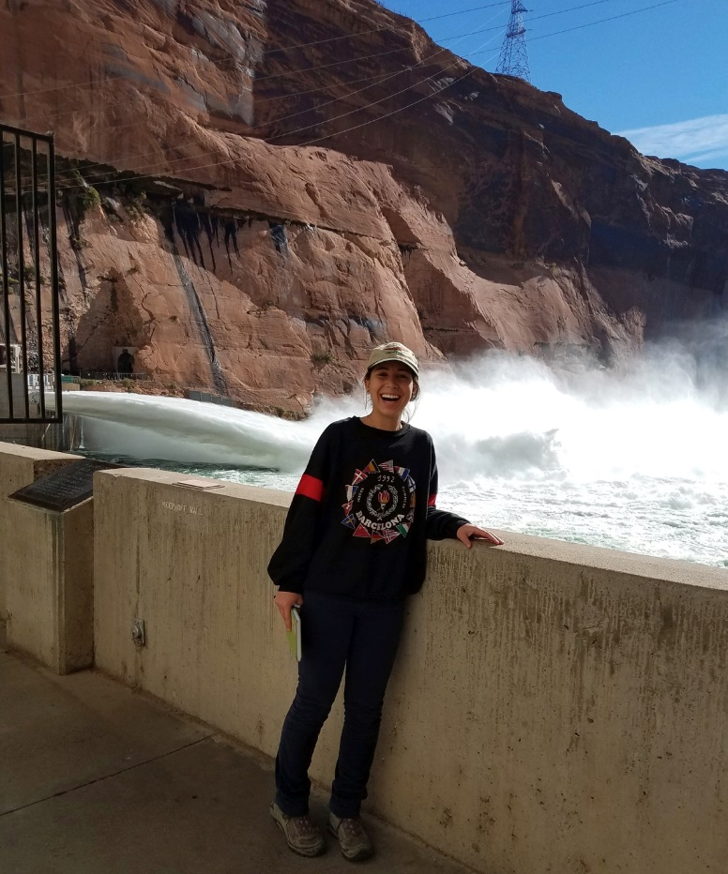
Student involvement
Published (by 4/7):
Inside the Glen Canyon Dam during a high-flow experiment
Fighting uranium contamination with education
Exploring space on TV just as challenging
In progress:
Flagstaff on the way to beecoming pollinator city
Drought-quenching bacteria the future of farming?
Go Baby Go
NAU students impress at NASA space grant symposium
Articles available at AZDailySun.com
Glen Canyon Dam HFE
Notes:
Interview with graduate student Rachel Rubin
Symbiotic, growth-promoting rhizobacteria
Meta-analysis
Potential to enhance food security, water conservation, and sustainability

Slide 4
Why is science communication important?
Popular science writing is a tool for:
Promoting science literacy
Encouraging interest in STEM fields
Overcoming inaccessibility of scientific language
Establishing relevance
Notes:
Anecdote of working at grand canyon: science literacy is a problem, though it’s hard to believe while at this conference

Slide 5
Can’t-do Catch Phrases
Liberal Arts
“I can’t do math.”
“I don’t have a science brain.”
“Just looking at an equation confuses me.”
“I can’t think that way.”
“It’s like magic.”
STEM
“I can’t read words over 3 syllables.”
“I don’t have an English brain.”
“I can’t comprehend complex sentences.”
“I can’t think that way”
“It’s like magic.”
False dichotomy between STEM and Liberal Arts fields
Notes:
Mention students’ complaint about having to take liberal studies courses
Actual overheard phrases
Culturally acceptable

Slide 6
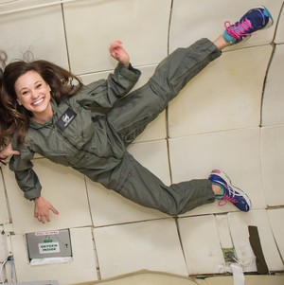
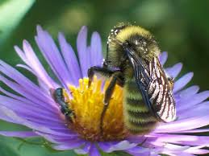
Encourage interest
Spark research and further questions
Share exciting new information and discoveries
Story: Exploring space on TV just as challenging
Communicate objective truth
Promote citizen science
Story: Flagstaff on the way to beecoming pollinator city
Emily Calandrelli, Xploration Outer Space
Friendly neighborhood pollinator
Notes:
Spark:
article is a short commitment
even without interest, you may still read
sometimes people just see headlines
Share exciting news:
we are not stagnant. We are constantly developing, discovering, innovating
story that highlights this: exploring space on tv just as challenging, emily calandrelli
exciting space news examples!
Communicate obj: in an age of alternative facts and fake news, we must defend objective truths.
One of the most tasteful things about STEM: science is true whether you believe it or not
Article in progress
Interview with Ellen Vaughan, Queen Bee
Pollinators are responsible for:
33% of our food
Reproduction of 88% of flowering plants world-wide
Globally: 20,000 bee species
Arizona: 1,700 species
San Francisco Peaks: 260 species
Cross Polination: Celebrating Pollinators with Art and Science

Slide 7
Why not read scientific journals?
Often inaccessible
Requires background knowledge
Use of specialized language
Tone
Concise
Informative
Notes:
Based on your reaction, I see that you all already know why
Need to appreciate the fact that this is not a bad thing.
Everyday person should not be able to understand research, or else why would we have specialists in every field?
We just wouldn't’t read journals as a way to communicate with the everyday person, so all this science research is inaccessible. How can we explain this research to someoe without a background? And how do we make it interesting?

Slide 8

Learning Outcomes: From Scientist to Journalist
Turnover time
Self set deadlines and balance
Getting the scoop
Developing an angle and telling a story
Value of first hand experience
Interview management and organization
Relevance- Why do we care?
Notes:
Turnover time different than deadlines-→
you don’t want your story to be “old News”
No hard due dates, so it was easy to put off with the never ending stream of sneior year full time coarse load
But if you waited too long, old news, loss of relevance (IN SOME CASES)
In other cases, if no event, you could wait and really delve deep into the subject matter to tell a story, with interwoven science
Interview: what sorts of questions to ask?
What can I gain face to face that I cannot gain over the phone or via email?
Article in progress
Interview with graduate student Rachel Rubin
Symbiotic, growth-promoting rhizobacteria
Meta-analysis
Potential to enhance food security, water conservation, and sustainability

Slide 9
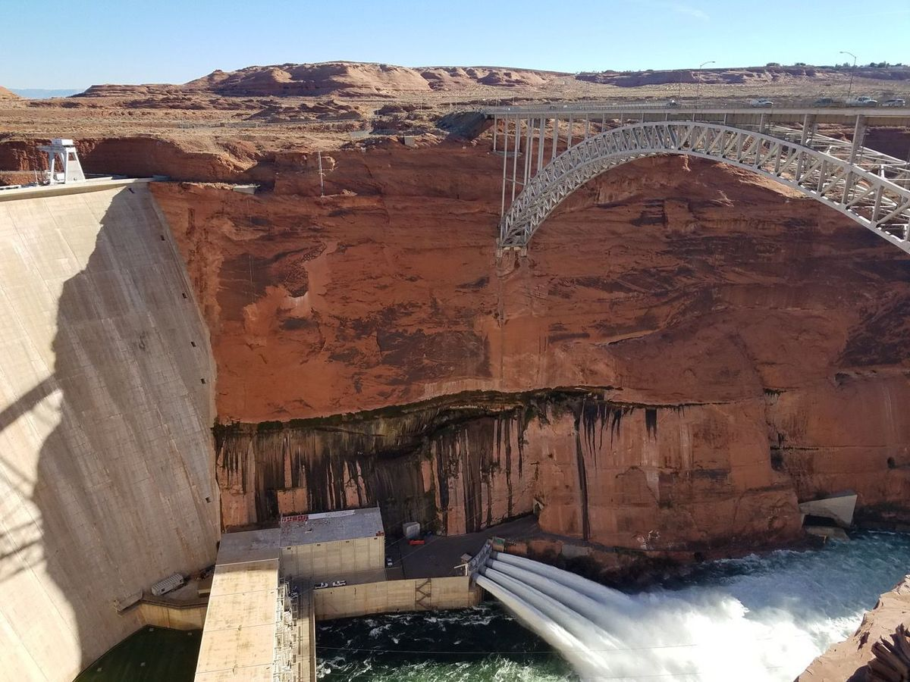
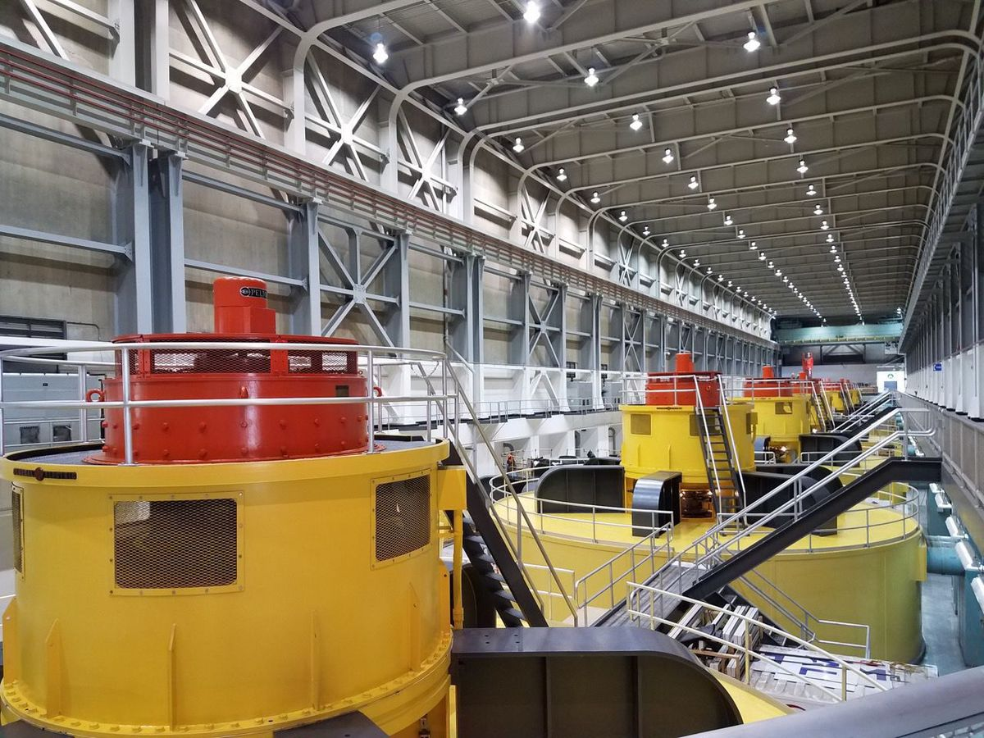
First-hand account: Inside the Glen Canyon Dam during a high-flow experiment
First-person
Controlled flood experiment on the Colorado River
November 2016 HFE
Inside the turbine room
Notes:
Article in progress
Interview with Dr. Ryan Porter, Assistant Professor, NAU Geology
The art and application of scientific modelling in research
Heat played a key role in Colorado Plateau uplift

Slide 10
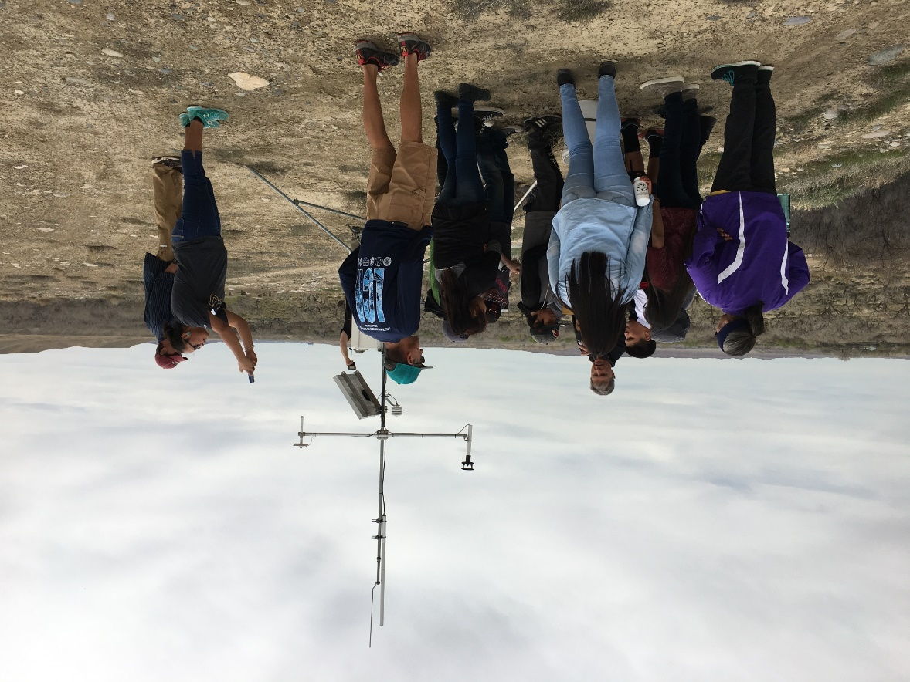
Highlighting community issues: Fighting uranium contamination with education
Interview with Athena Talk
Uranium, Radiation and Radon Education and Outreach internship
NASA Space Grant
Institute for Tribal Environmental Professionals
“I hope that [education] will go beyond first hand stories, and give students and other community members a better, more scientific understanding in attempt to reduce fear surrounding the topic of uranium and its legacy” –Athena Talk

Slide 11
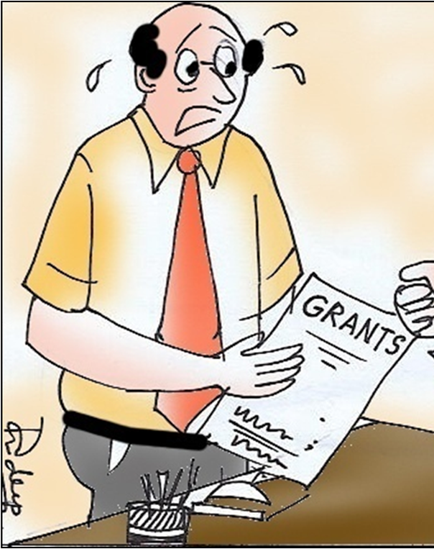
Future Work
Complete articles in progress
Challenge: relevance

Slide 12
Acknowledgements
Randy Wilson, The Arizona Daily Sun, Editor
Ted Martinez MS, Lecturer, NAU Honors College
Dr. Nadine Barlow, Director, NAU/NASA Space Grant
Kathleen Stigmon, Sr. Program Coordinator, NAU/NASA Space Grant

Slide 13
Questions?

